Slide 1
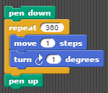
Lesson 3.2 Review: Identifying concepts
Identify which of the techniques we learned in lesson 3.2 these are examples of:
Using this SNAP script to draw a circle:
Copying an identical script for multiple enemies in a SNAP program
Creating sprites for walls and movable objects to implement collision detection in a game.
Using the SNAP block touching instead of comparing x and y positions

Slide 2
Lesson 3.3
Procedures

Slide 3
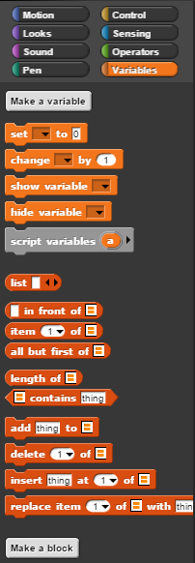
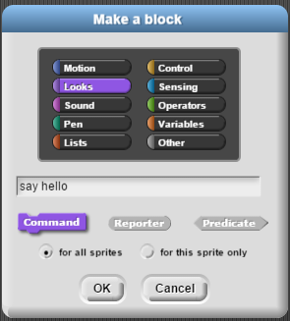
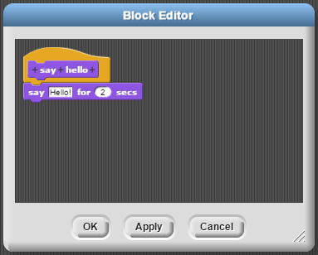
Custom command blocks
In Make a block you can choose the category and name your block.
In the Block Editor you can create the script for your custom command block in the same way you would create a script in the main scripting area

Slide 4
Custom command blocks
Write a custom command block that causes your sprite to glide any direction in a zig zag pattern
Now use that custom block to create a script that causing your script to say “Evasive maneuvers!” and zig zag when space is pressed

Slide 5
Command blocks
Take a second to look over some of your old labs and write down a few examples of places where the abstraction technique of creating command blocks could be useful.

Slide 6
Lab 3.3 Drawing Shapes (Again)
We have drawn A TON of shapes for this class, now we can finally write custom blocks to do that for us!
Reuse code from previous labs for your scripts in part one
If you know how to make input variables… DON’T! Use variables from the main scripting area inside of your custom command blocks

